Slide 1
ONE PERSON IN GROUP-> CLICK USE TEMPLATE
WHEN THE COPIED TEMPLATE OF THESE SLIDES OPENS IN A NEW TAB:
ADD YOUR Group NAME TO THE TITLE
SHARE WITH GROUP MEMBERS (USE SHARE BUTTON)
COPY THE TITLE AND LINK TO YOUR RECORDS (Digital folder/table of contents)
Remember it is advisable to make a PERSONAL copy and link it when DONE

Slide 2
Solution Stoichiometry.

Slide 3
ESSENTIAL QUESTIONS
Remember, you should be able to thoroughly answer these AFTER learning through following resources.
How can we calculate dilutions and concentrations we need in the lab?
How can we safely prepare dilutions for our needs?

Slide 4
Instructions
Follow through the Engage to Apply resources in order .
Once complete, choose from Extend resources as interested.
Record your learning in your these slides- Remember to keep track of where to find these slides for studying!
Complete the Essential Questions Response in the Apply Section.
Try the Extend section and optional Apply practice as desired to deepen your understanding

Slide 5
Hyperdoc Elements
Click for quick access to:
Engage
Explore
Apply

Slide 6
Terminology - As you encounter terms new to you, define in your own words here, include examples (make them up!)

Slide 7
Part 1: ENGAGE

Slide 8
Explore - Part A: 5 minutes
Importance of Stoichiometry
Go to Real Life Stoichiometry and scroll down until you see “1. Airbags”. Each group member choose a different application to read (air bags, rockets etc).
Share briefly with your group and explain what could happen if the stoichiometry is incorrectly applied in your application.

Slide 9
Part 2: EXPLORE

Slide 10
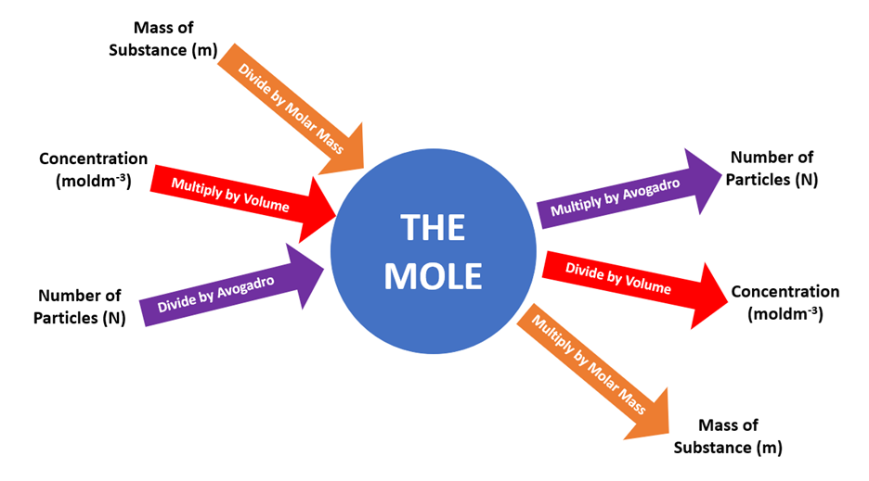
Explore - Solution Stoichiometry
Stoichiometric Calculations can be performed using Solutions with known volumes and concentrations
These can be used to calculate the volumes, concentrations, moles or masses of other compounds

Slide 11
Explore - Solution Stoichiometry
Stoichiometry with solutions involves an extension to the problem solving map.
You already know how to calculate the moles of given from the starting points of mass or number of particles.
Now you can use the M = n/V formula to calculate moles from a starting solution.
See the next slide and discuss as a group to ensure you understand.
Stoichiometry remains the same: You need to determine the moles of the given, use the molar ratio to determine the moles of required then convert to what is asked for (mass, particles or solution)

Slide 12
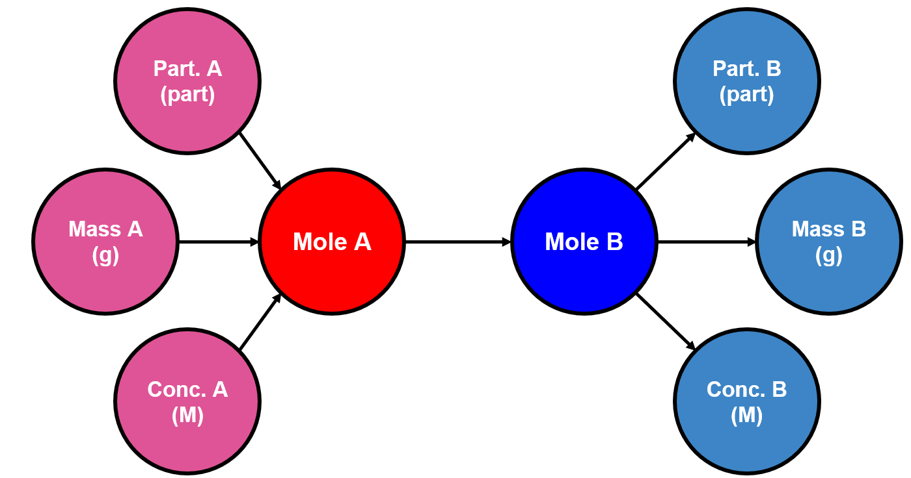
Explore - Solution Stoichiometry
Determine the moles of given using
n = MV
Determine the conc. of required using
M=n/V
Part. = particles

Slide 13

Explore - Practice 1 - Concentration from Mass
100.0mL of AgNO₃ (unknown concentration) is reacted with excess solid copper. After leaving the reaction for a few days, 1.65g of Silver was precipitated out. What was the original AgNO₃ concentration? (use a charge of +1 for the copper ion that forms) Ans: 0.153M
AgNO₃ + Cu → CuNO₃ + Ag ** Always check for balancing!
Try yourselves on a Whiteboard then remove this box to check your process.
* Hint start with a balanced chemical equation & list your givens!
MASS
m = 1.65g
MOLE (Given)
n_{G} = 0.015 mol
MOLE (required)
n_{R} = 0.015 mol
CONC.
M =0.15mol/L
x 1Ag
1 AgNO₃
M = n/V
= 0.015mol
0.1L
n = m/MM
= 1.65g
107.87g/mol

Slide 14
Explore - Practice 2 - Limiting Reagent
Aluminium sulphate reacts with calcium nitrate. If 20.0mL of 0.0150M Aluminum Sulphate and 30.0mL of 0.0185M Calcium nitrate react, which is the limiting reagent? How much (mass) precipitate is formed?
** Use your stoichiometry knowledge! Balance first :) If you are unable to get the correct answer, confer with another group and then your teacher.
Ans: Limiting reagent is Ca(NO₃)₂. Using the solubility table, the precipitate is CaSO₄ and 0.0756g are formed.
Move this box to check your answer after trying. Feel free to check steps with other groups as you go. Eg. Did you get the same product as the precipitate?

Slide 15
Explore - Practice 3 - “Fully React”
What volume of 0.125M HCl is required to fully react with 0.500g of CaCO₃ ? 2HCl _{(aq)} + CaCO_{3 (aq)} → CaCl_{2 (aq)} + H₂O_{(l)} + CO_{2 (g)}
Discuss what “fully react” means in terms of the molar ratios in a chemical equation. Ensure you are able to solve for the answer below!
Ans: 79.9mL

Slide 16
Explore - Practice 4 - Minimum Volume
What volume of 0.4M HCl is needed to completely neutralize 47.1mL of 0.75M Ba(OH)₂ ?
Discuss the similarities and differences between this question and the previous (Practice 3) question. What steps are needed to solve this? Ensure you are able to solve for the answer below!
Ans: 176mL HCl

Slide 17

OPTIONAL Video help

Slide 18
Part 3: Apply

Slide 19

Apply- Complete the questions
Show all your work! Include formulas, conversions, units, etc.
Silver Chromate, Ag₂CrO₄, is insoluble. Calculate the mass of silver chromate that forms when 50.0mL of 0.200 mol/L silver nitrate reacts with 50.0mL of 0.150 mol/L sodium chromate. Ans: m = 1.66g
Seek assistance from peers/teacher if you are unable to get the indicated answers to any problems.

